Slide 1
Usage of ClusterR Package
Corrado Alessio, Zuccato Francesco
Statistica applicata - 2023

Slide 2
Contents
Introduction to unsupervised learning
Cluster analysis
Data generation
Provided models for clustering
Performance evaluation
Execution times
Centroid vs medoids
Provided datasets

Slide 3
Introduction to unsupervised learning
Supervised vs unsupervised learning
Cluster analysis methods
Connectivity based
Centroid based
Distribution based
Density based

Slide 4
Cluster analysis – Connectivity based
Create connections between clusters
Tree vs forest
Agglomerative (Divisive) Hierarchial Clustering

Slide 5
Cluster analysis - Centroid based
Centroids in R^n
Dissimilarity metrics (Euclidean, Manhattan, Max)
Centroid (K-means) vs medoid (K-medoid)

Slide 6
Cluster Analysis – Distribution based
Data explained by a probabilistic model
Data belongs to the cluster that maximizes the generating probability
Generalizes centroid-bases (all centroids with the same gaussian distribution)
Gaussian Mixture Models

Slide 7
Cluster analysis – Density based
Distance between points
Dense connected regions
No prior number of clusters
DBSCAN, OPTICS

Slide 8
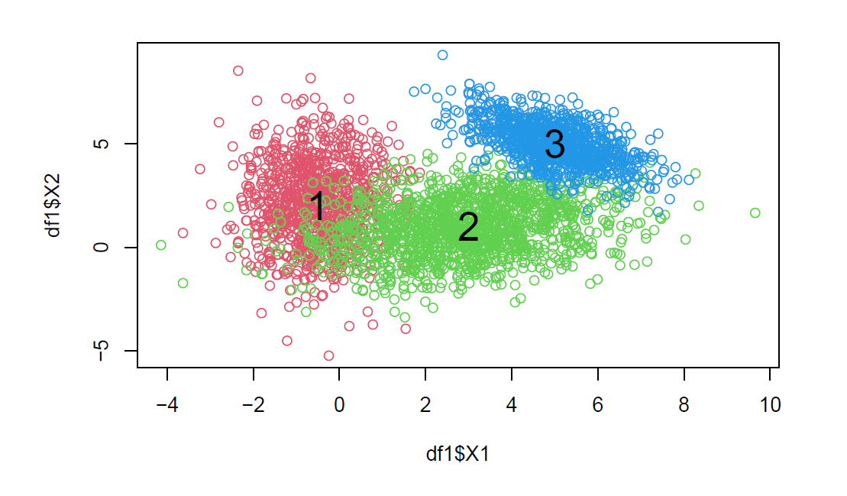
Data Generation
Synthetic dataset with 3 clusters, generated by different gaussian distributions
rnorm R function

Slide 9
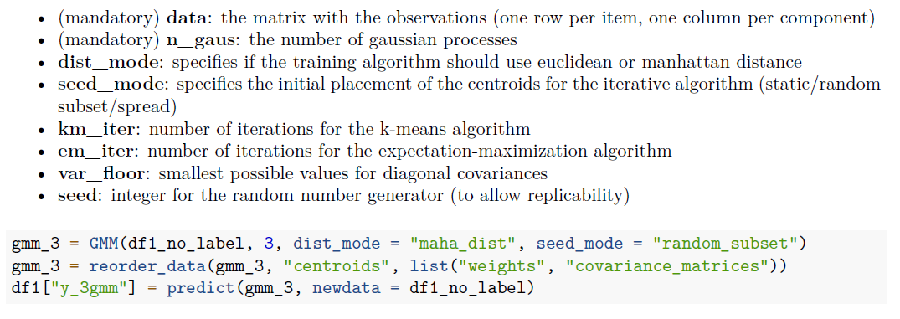
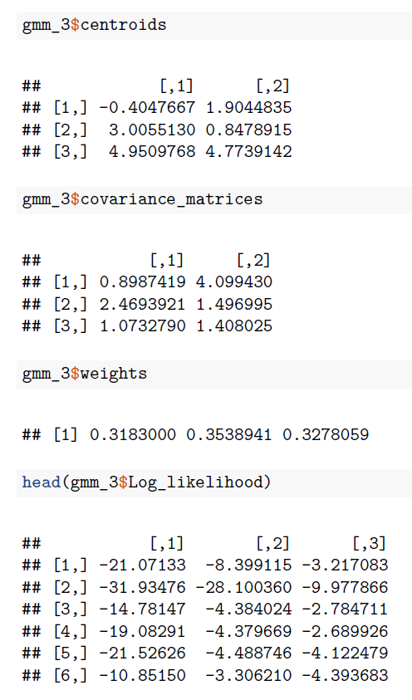
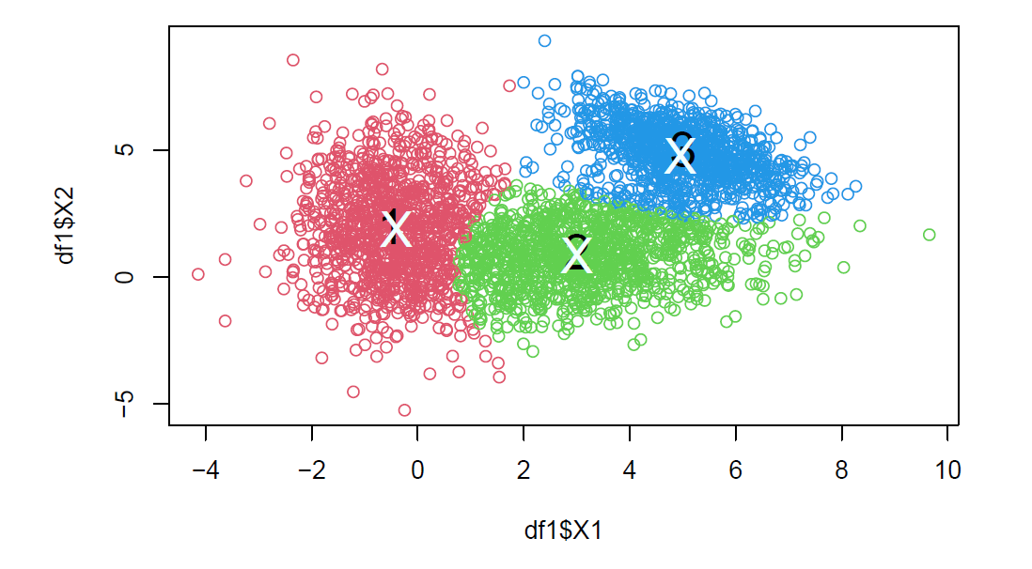
Provided models for clustering – Gaussian Mixture Models

Slide 10
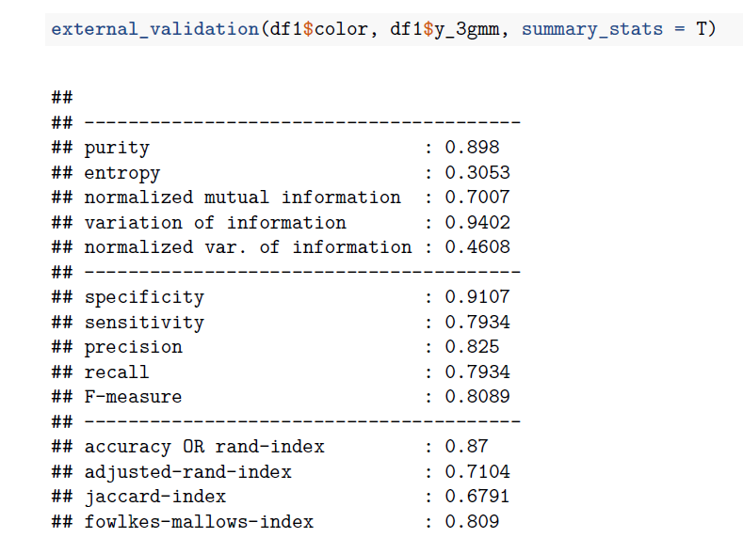
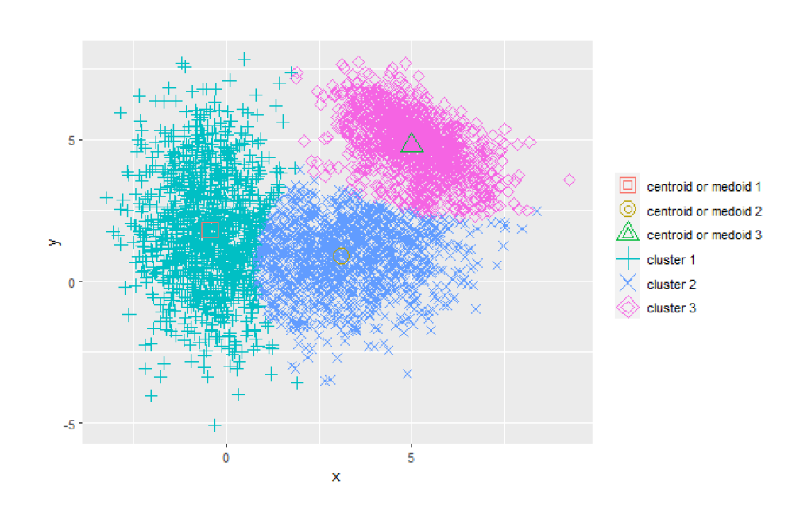
Plot_2d and external_validation

Slide 11
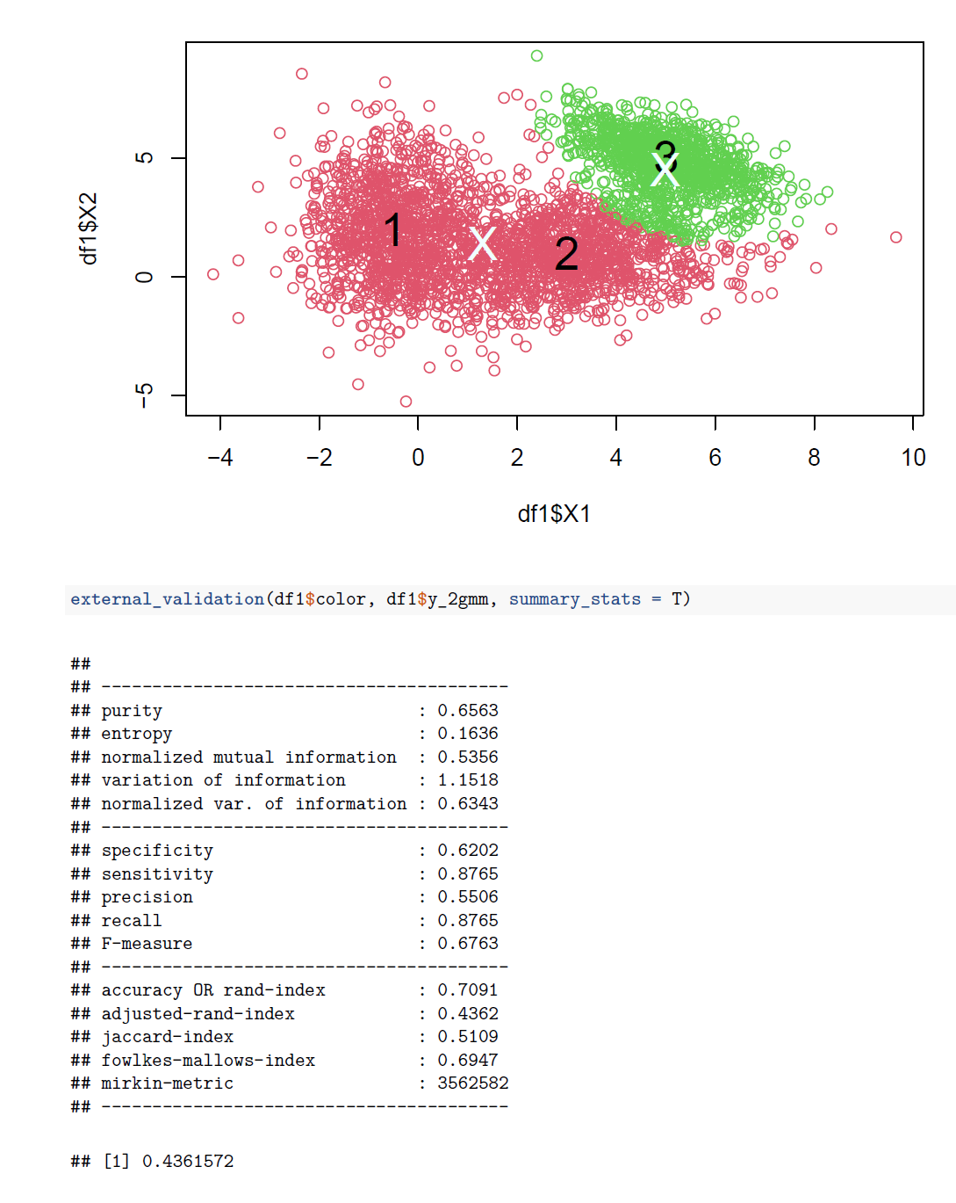
Different k

Slide 12
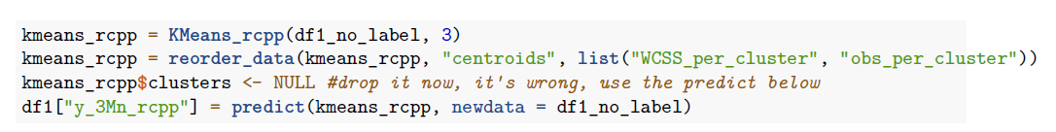
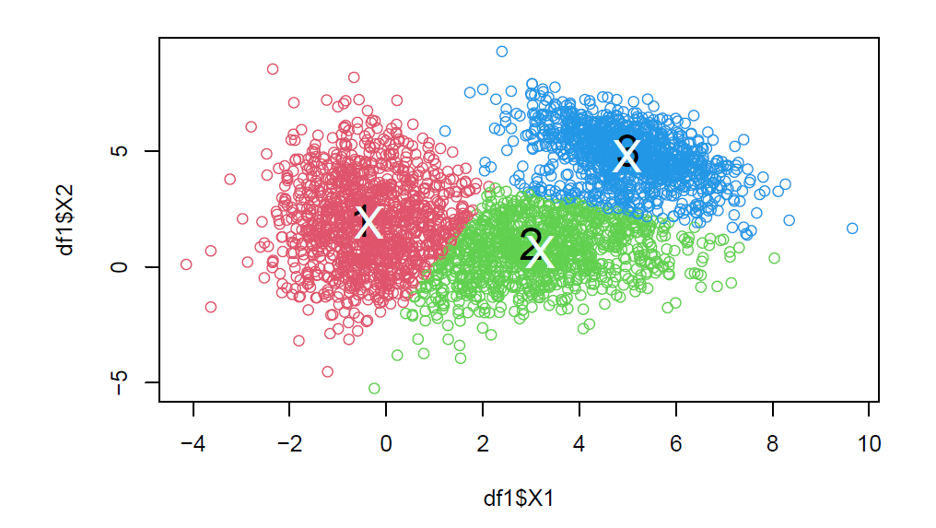
Provided models for clustering – K-means
Kmeans_arma vs Kmeans_rcpp
Common attributes
Data
Clusters
CENTROIDS
Verbose
Kmeans_rcpp
Num_init
Max_iters
Output
Call, centroids
Clusters
Best_initialization
metrics

Slide 13
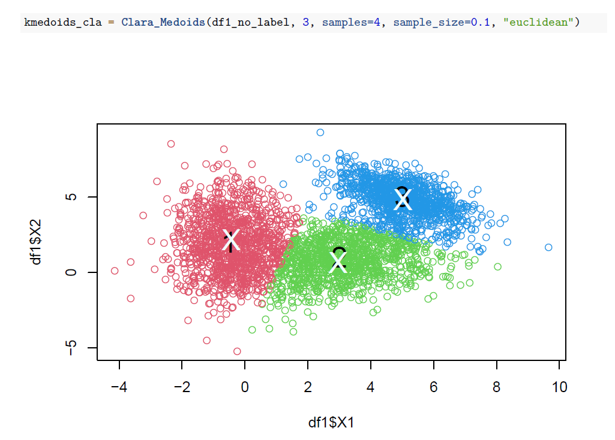
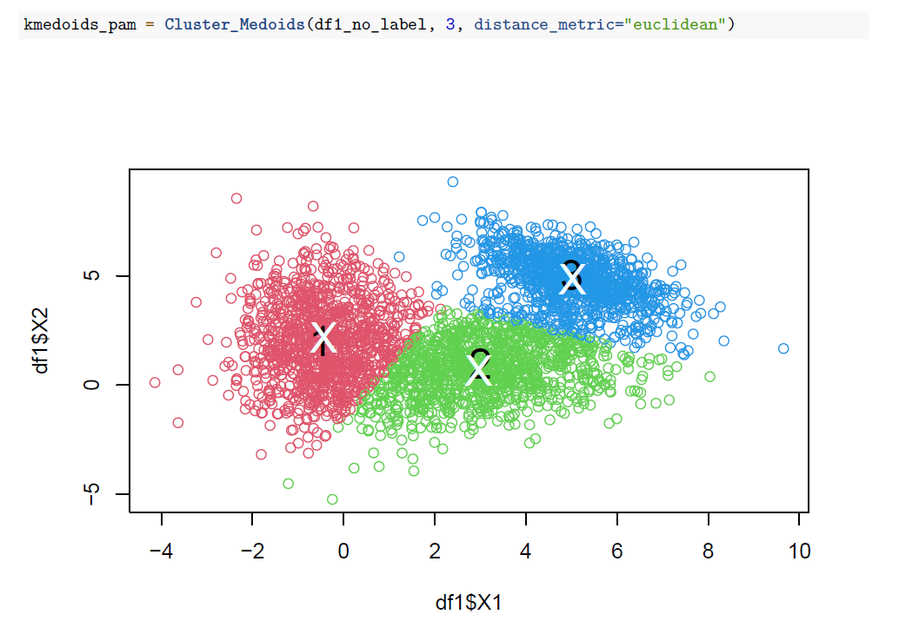
Provided models for clustering – K-medoids
Partitioning Around Medoids (PAM)
BUILD
SWAP
Cluster_Medoids vs Clara_Medoids

Slide 14
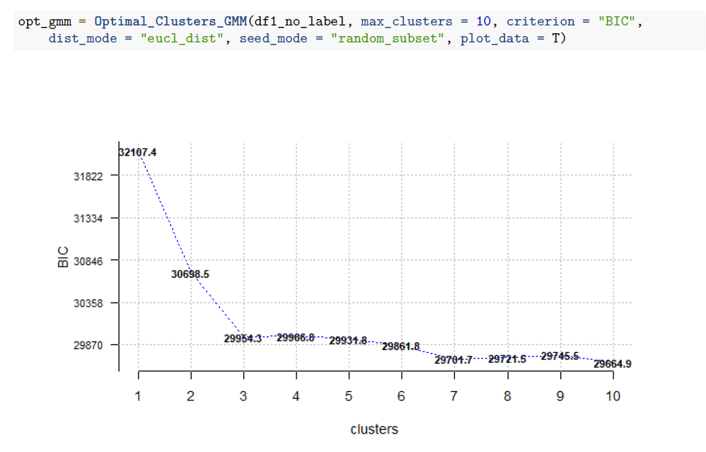
Finding optimal number of clusters
Optimal_* methods
Elbow method
Criterion (AIC, BIC)

Slide 15
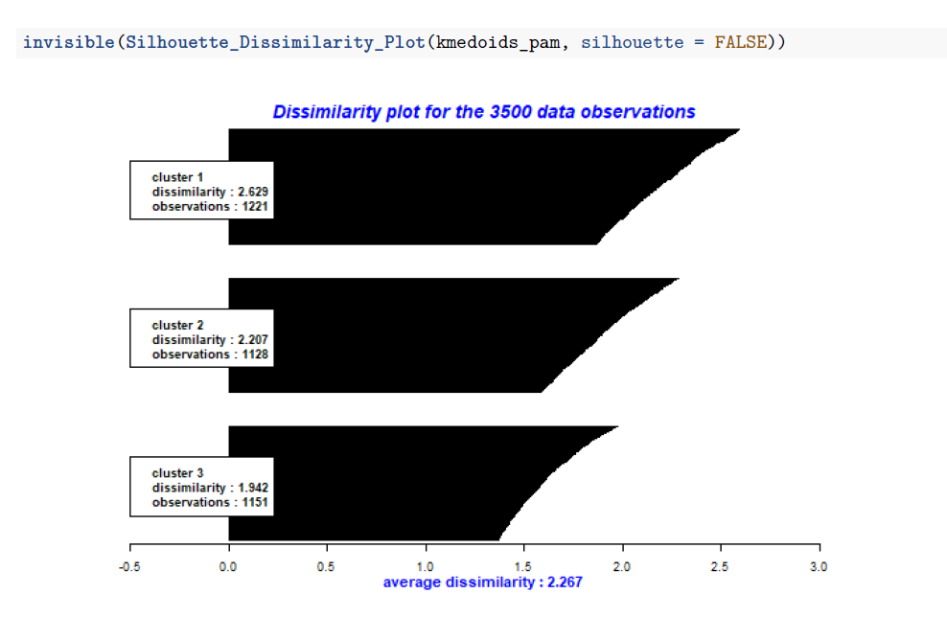
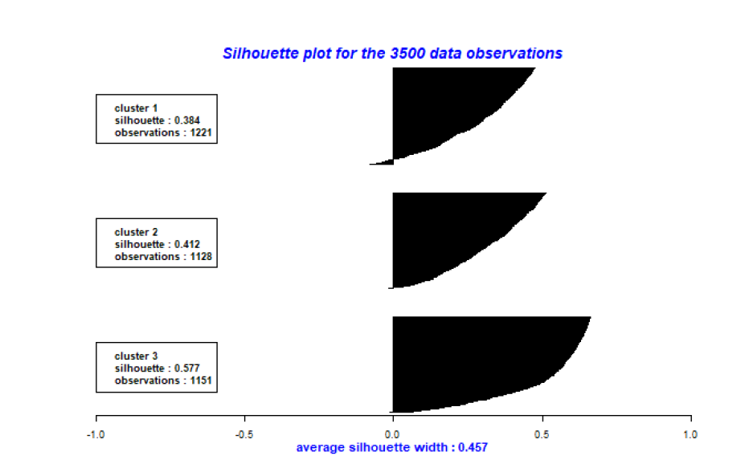
Silhouette plot
Cohesion vs separation
Range [-1; 1]
Average silhouette vs dissimilarity

Slide 16
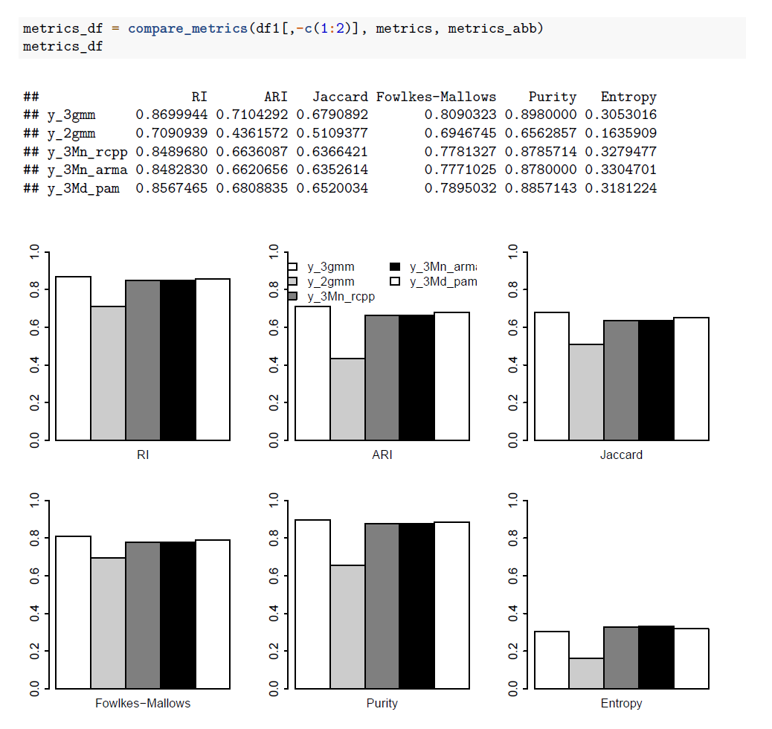
Method comparisons

Slide 17
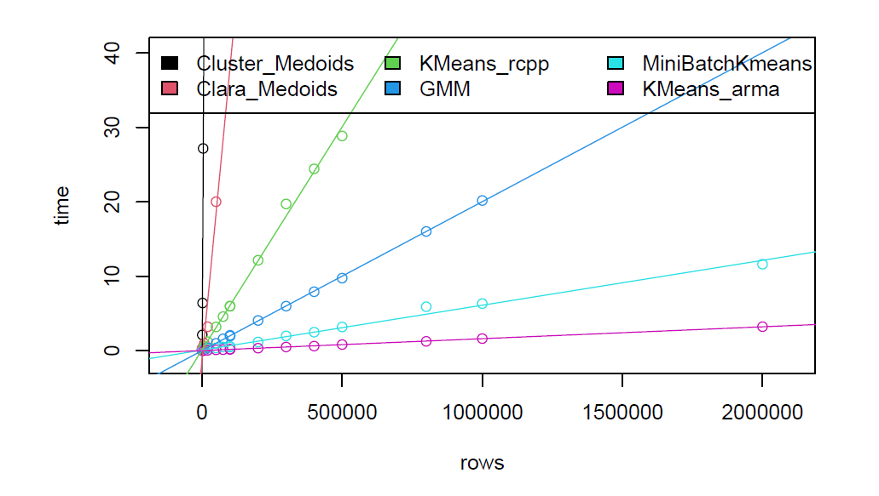
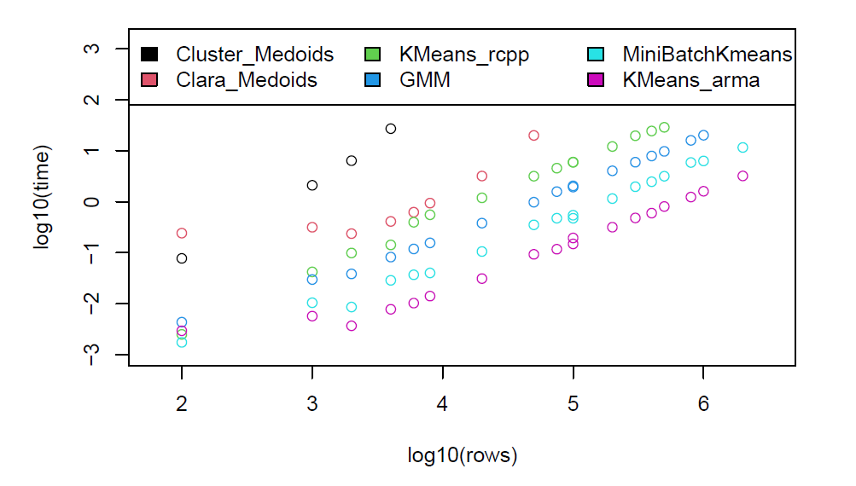
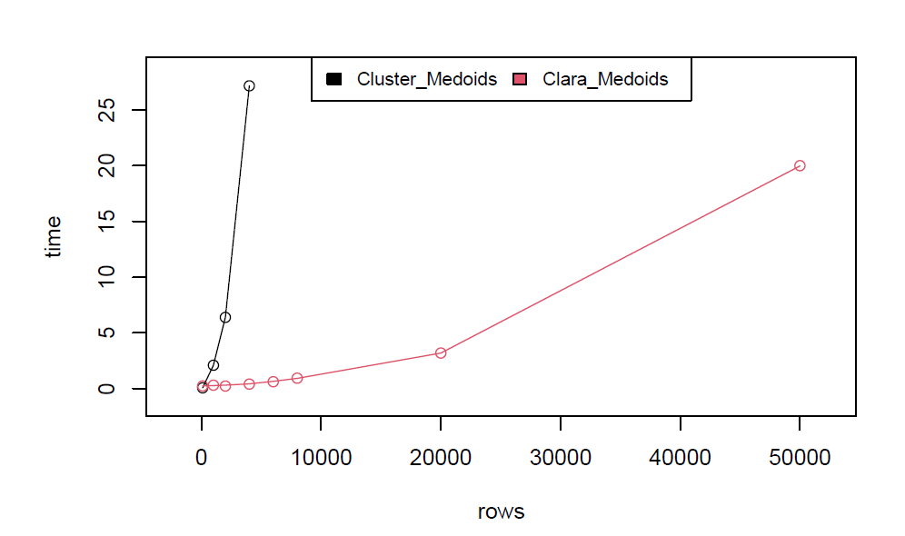
Execution times

Slide 18
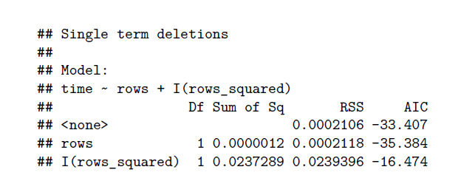
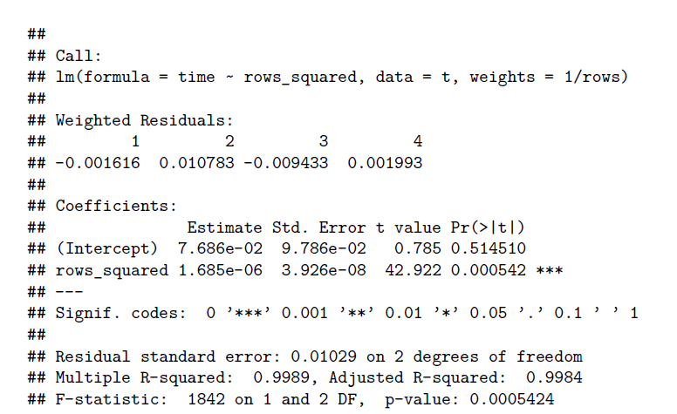
Execution times – Cluster_Medoids

Slide 19
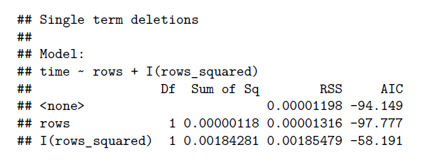
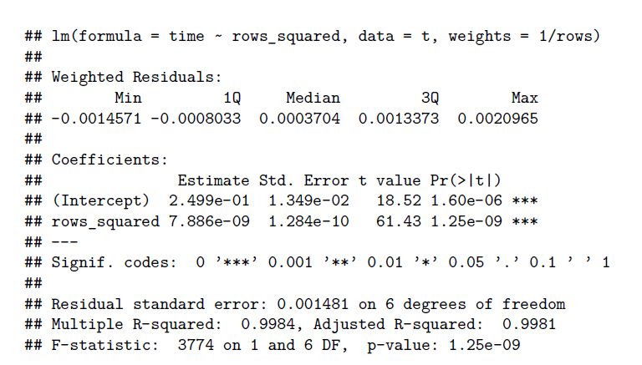
Execution times – Clara_Medoids

Slide 20
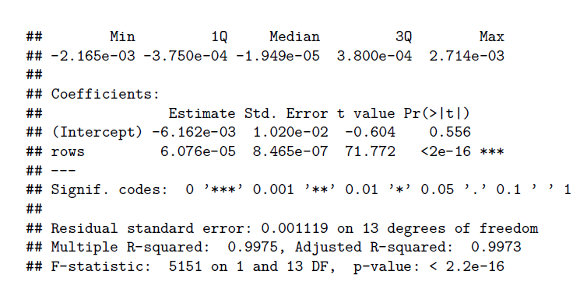
Execution times – Kmeans_rcpp

Slide 21
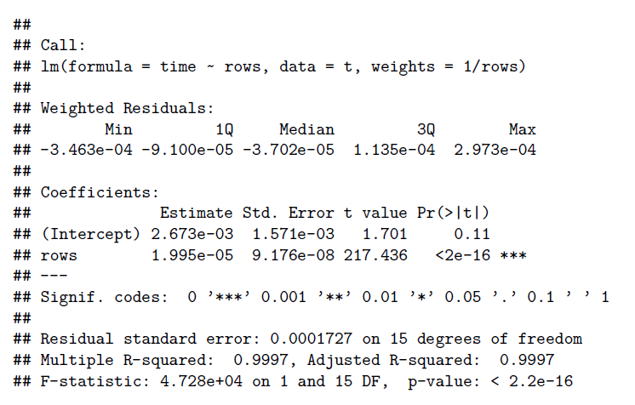
Execution times – GMM

Slide 22
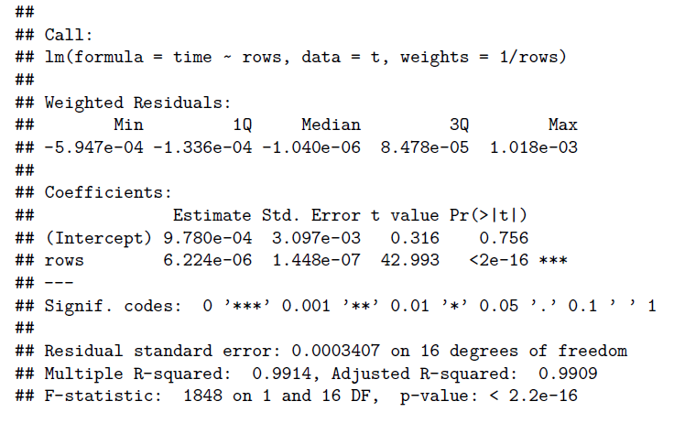
Execution times – MiniBatchKMeans

Slide 23
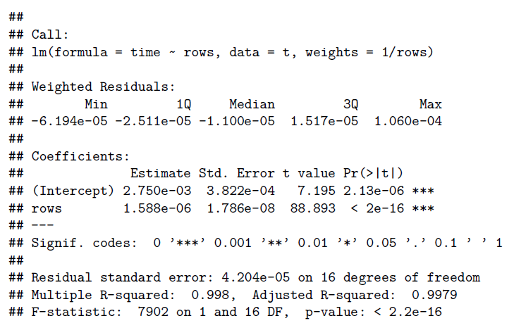
Execution times – Kmeans_arma

Slide 24
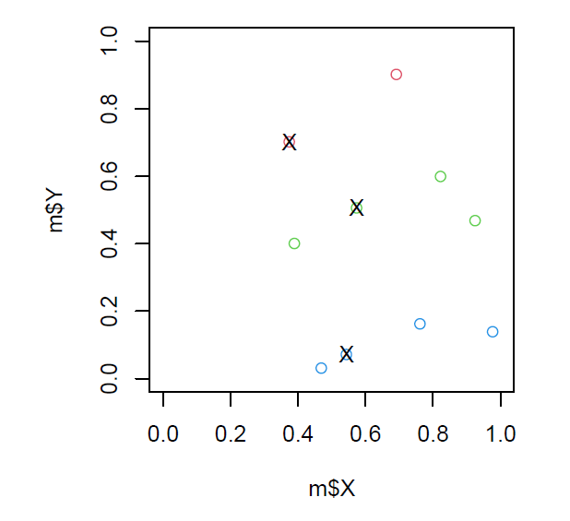
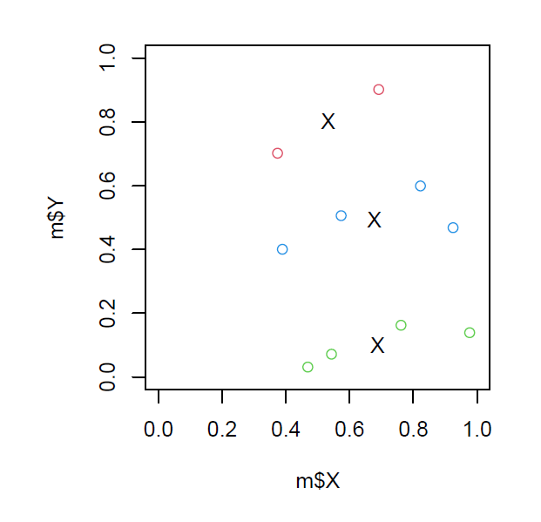
Centroids vs Medoids

Slide 25

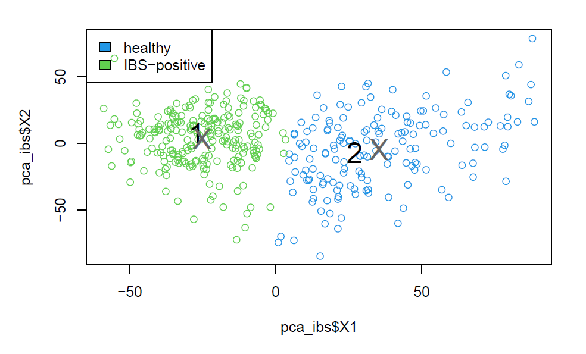
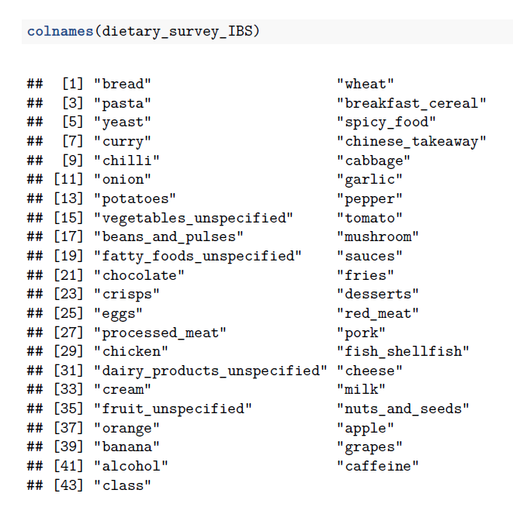
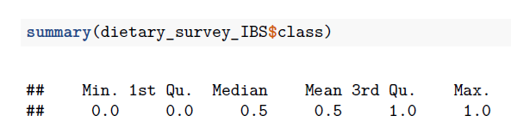
Datasets – dietary_survey_IBS

Slide 26
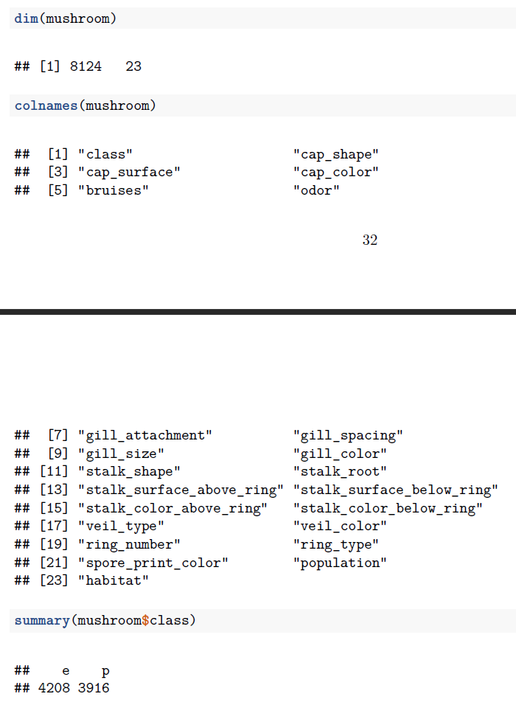
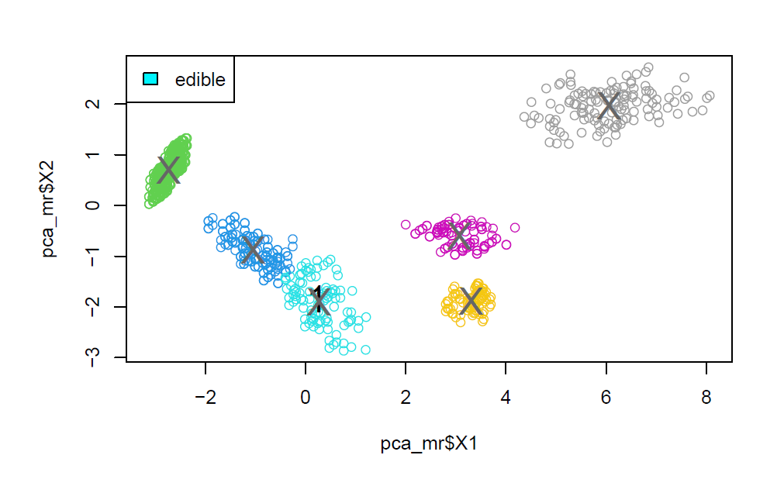
Datasets - mushroom

Slide 27
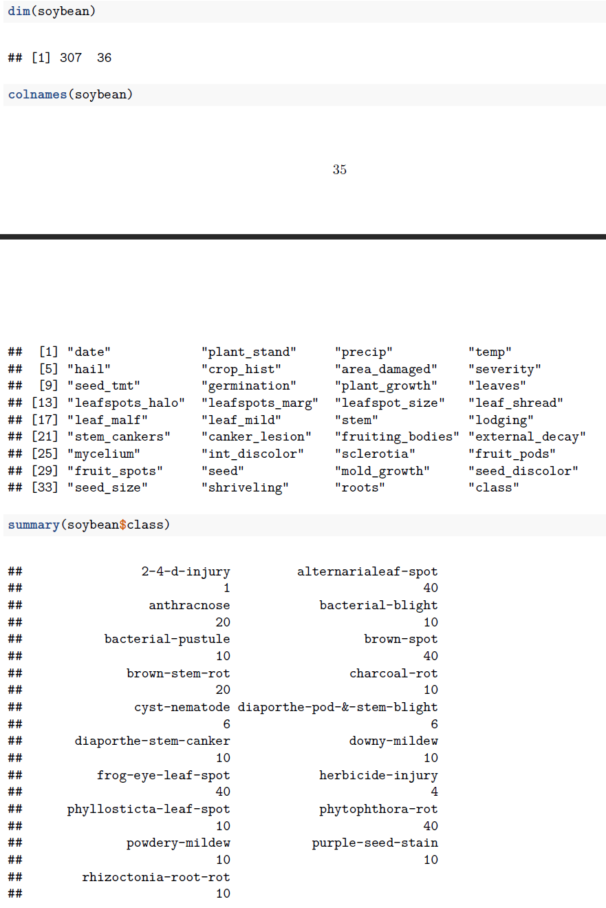
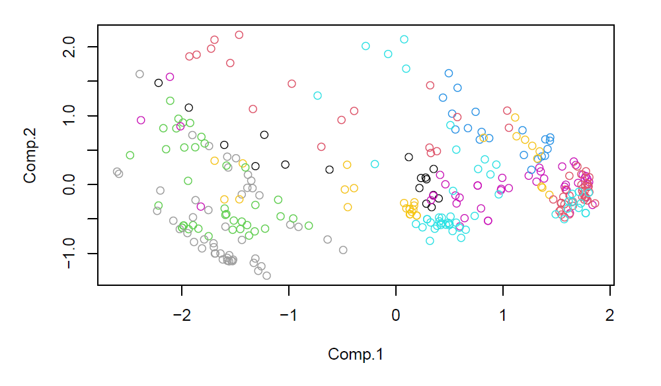
Datasets - soybean

